Slide 1
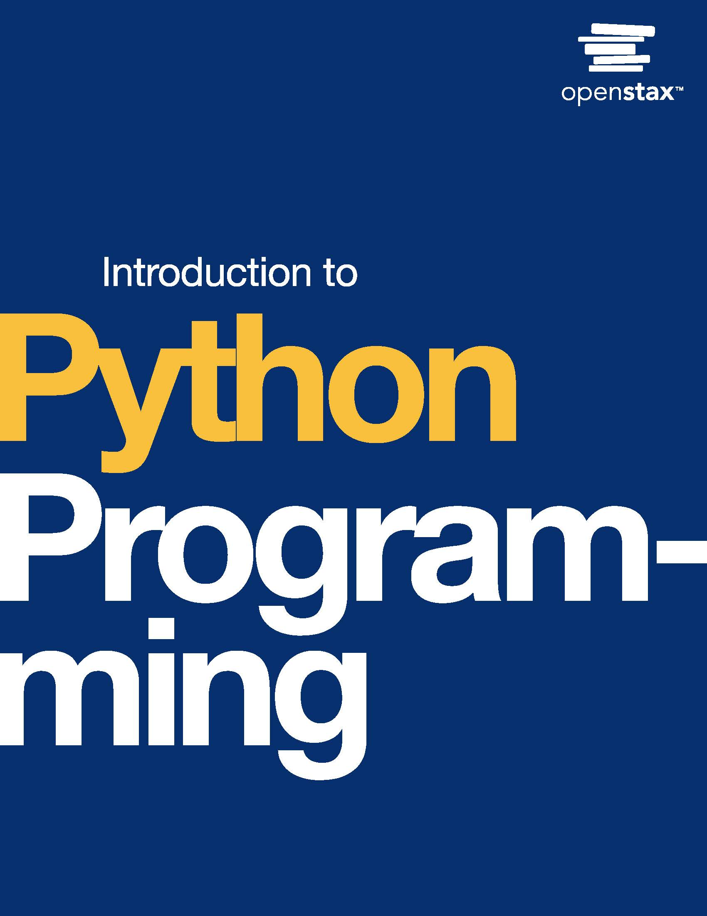
Introduction to Python Programming
Chapter 6: Functions

Slide 2
Chapter outline
Defining functions
Control flow
Variable scope
Parameters
Return values
Keyword arguments

Slide 3

Figure 6.1
credit: modification of work "IMG_3037", by Jay Roc/Flickr, Public Domain
Notes:
overhead view of arcade games with people playing the games

Slide 4
6.1 Defining functions
Learning Objectives
Identify function calls in a program.
Define a parameterless function that outputs strings.
Describe benefits of using functions.

Slide 5
6.1 Defining functions
A function is a named, reusable block of code that performs a task when called.
A function is defined using the def keyword.
The first line contains def followed by the function name (in snake case), parentheses (with any parameters—discussed later), and a colon.
The indented body begins with a documentation string describing the function's task and contains the function statements. A function must be defined before the function is called.

Slide 6
6.2 Control flow
Learning Objectives
Identify the control flow of a program.
Describe how control flow moves between statements and function calls.

Slide 7
6.2 Control flow
Control flow is the sequence of program execution. A program's control flow begins at the main program but rarely follows a strict sequence.
Ex: Control flow skips over lines when a conditional statement isn't executed.
When execution reaches a function call, control flow moves to where the function is defined and executes the function statements.
Then, control flow moves back to where the function was called and continues the sequence.

Slide 8
6.3 Variable scope
Learning Objectives
Identify the scope of a program's variables.
Discuss the impact of a variable's scope.

Slide 9
6.3 Variable scope
A variable's scope is the part of a program where the variable can be accessed.
A variable created outside of a function has global scope and can be accessed anywhere in the program.
A Python program begins in global scope, and the global scope lasts for the entire program execution.

Slide 10
6.3 Variable scope
Local scope
A variable created within a function has local scope and only exists within the function.
A local variable cannot be accessed outside of the function in which the variable was created.
After a function finishes executing, the function's local variables no longer exist.

Slide 11
6.4 Parameters
Learning Objectives
Identify a function's arguments and parameters.
Describe how mutability affects how a function can modify arguments.

Slide 12
6.4 Parameters
A function argument is a value passed as input during a function call.
A function parameter is a variable representing the input in the function definition.
Note: The terms "argument" and "parameter" are sometimes used interchangeably in conversation and documentation.

Slide 13
6.4 Parameters
Functions can have multiple parameters.
Ex: A function uses two parameters, length and width, to compute the square footage of a room.
Function calls must use the correct order and number of arguments to avoid undesired behavior and errors

Slide 14
6.4 Parameters
Modifying arguments and mutability
In Python, a variable is a name that refers to an object stored in memory, aka an object reference, so Python uses a pass-by-object-reference system.
If an argument is changed in a function, the changes are kept or lost depending on the object's mutability.
A mutable object can be modified after creation. A function's changes to the object then appear outside the function.
An immutable object cannot be modified after creation. So a function must make a local copy to modify, and the local copy's changes don't appear outside the function.
Programmers should be cautious of modifying function arguments as these side effects can make programs difficult to debug and maintain.

Slide 15
6.5 Return values
Learning Objectives
Identify a function's return value.
Employ return statements in functions to return values.

Slide 16
6.5 Return values
Returning from a function
When a function finishes, the function returns and provides a result to the calling code.
A return statement finishes the function execution and can specify a value to return to the function's caller.
Functions introduced so far have not had a return statement, which is the same as returning None, representing no value.

Slide 17
6.5 Return values
Using multiple return statements
Functions that have multiple execution paths may use multiple return statements.
Ex: A function with an if-else statement may have two return statements for each branch. Return statements always end the function and return control flow to the calling code.

Slide 18
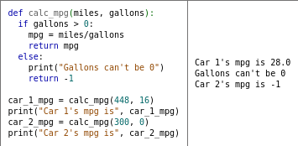
Table 6.1 Calculating miles-per-gallon and checking for division by zero.
In the table below, calc_mpg() takes in miles driven and gallons of gas used and calculates a car's miles per gallon.
calc_mpg() checks if gallons is 0 (to avoid division by 0), and if so, returns -1, a value often used to indicate a problem.

Slide 19
6.8 Keyword arguments
Learning Objectives
Describe the difference between positional and keyword arguments.
Create functions that use positional and keyword arguments and default parameter values.

Slide 20
6.8 Keyword arguments
Keyword arguments are arguments that use parameter names to assign values rather than order.
When mixing positional and keyword arguments, positional arguments must come first in the correct order, before any keyword arguments.
Functions can define default parameter values to use if a positional or keyword argument is not provided for the parameter.
Ex: def season(m, d, hemi="N"): defines a default value of "N" for the hemi parameter.
Note: Default parameter values are only defined once to be used by the function, so mutable objects (such as lists) should not be used as default values.

Slide 21
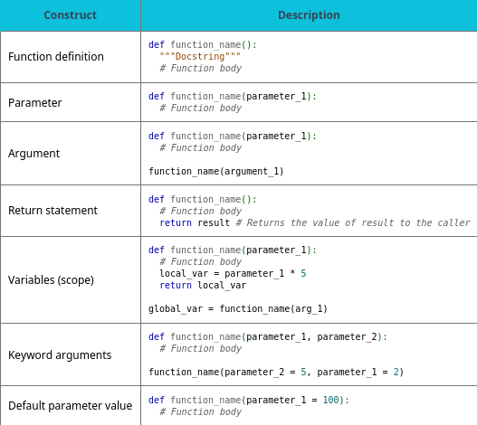
Table 6.2 Chapter 6 reference.

Slide 22
This ancillary resource is licensed under a Creative Commons Attribution-NonCommercial-ShareAlike 4.0 (CC BY NC-SA) license; it may be distributed, remixed, built upon for noncommercial purposes only, and must be attributed to OpenStax and redistributed under the same license.

